Slide 1

Amazon Sales Analysis
USING PYTHON
- Rohit Singh

Slide 2

INTRODUCTION
A comprehensive analysis of Amazon sales data, identifying key metrics and factors. This study showcases meaningful relationships between attributes such as Year, Month, Sales Channel, Order Priority, ,Region , Date and Country

Slide 3
Table of contents
Key Performance Indicators Order Priority based Analysis Year-month Trends Regional Insights Order Date Overview Country Comparison
01 - 02 - 03 - 04 - 05 - 06 –

Slide 4
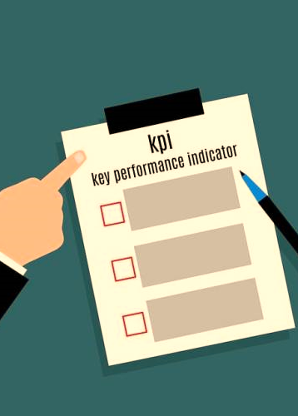
01
Key Performance Indicators

Slide 5
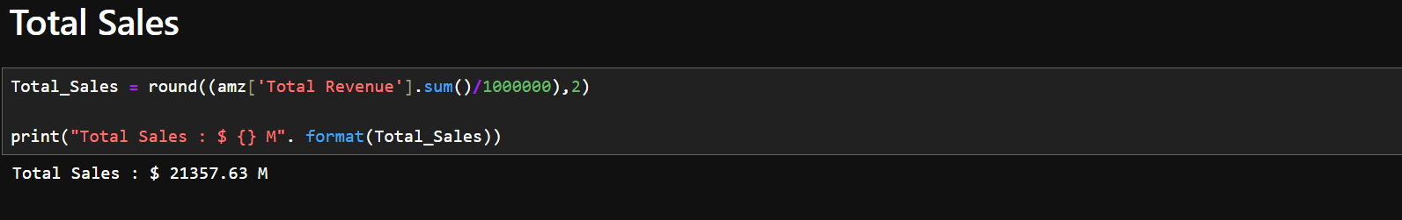
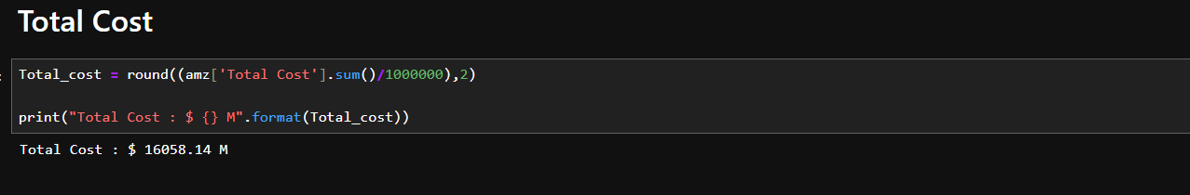
Total Sales & Total Cost

Slide 6
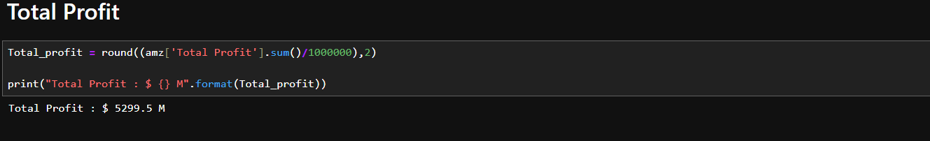
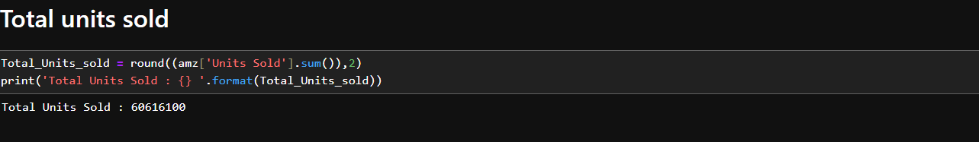
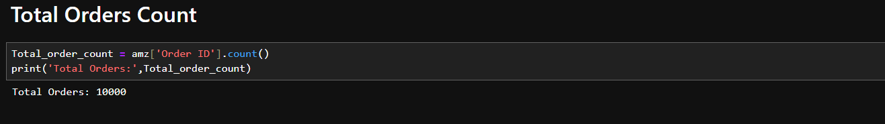
Total Profit & Total Unit Sold & Total Orders

Slide 7

02
Order Priority based Analysis

Slide 8
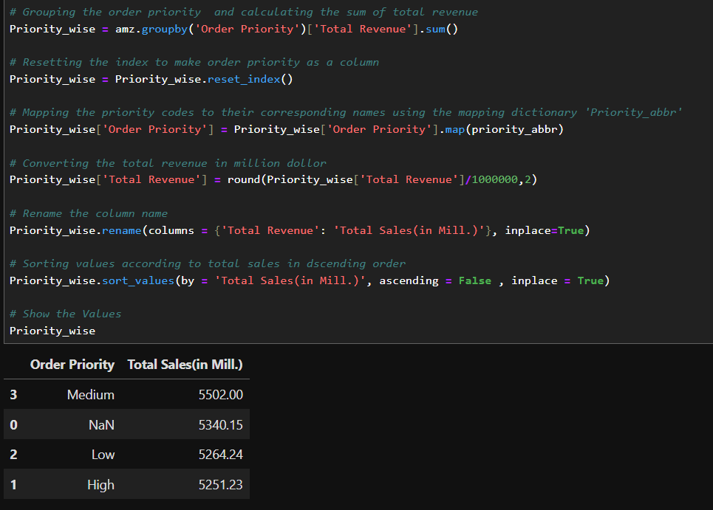
Order Priority wise Sales

Slide 9
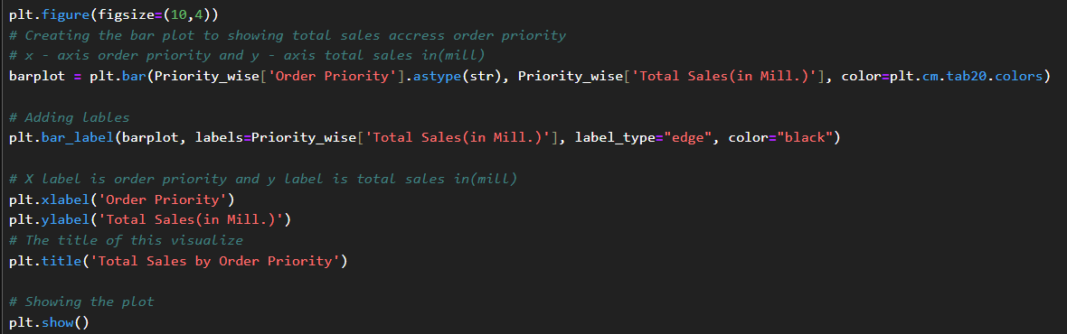
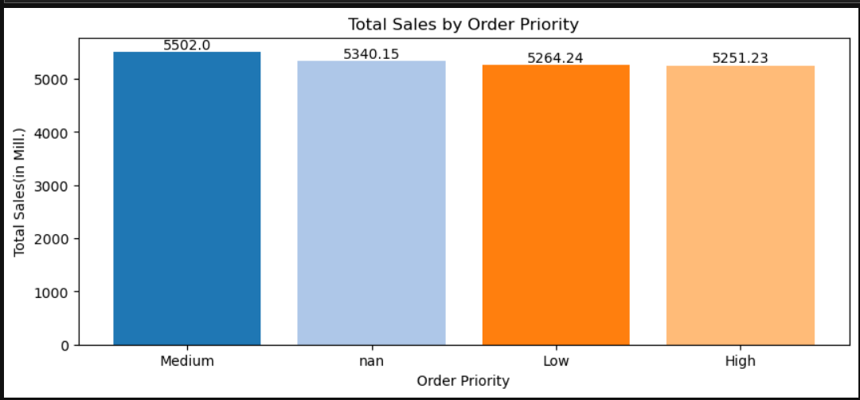
Visualizing Order Priority wise Sales

Slide 10
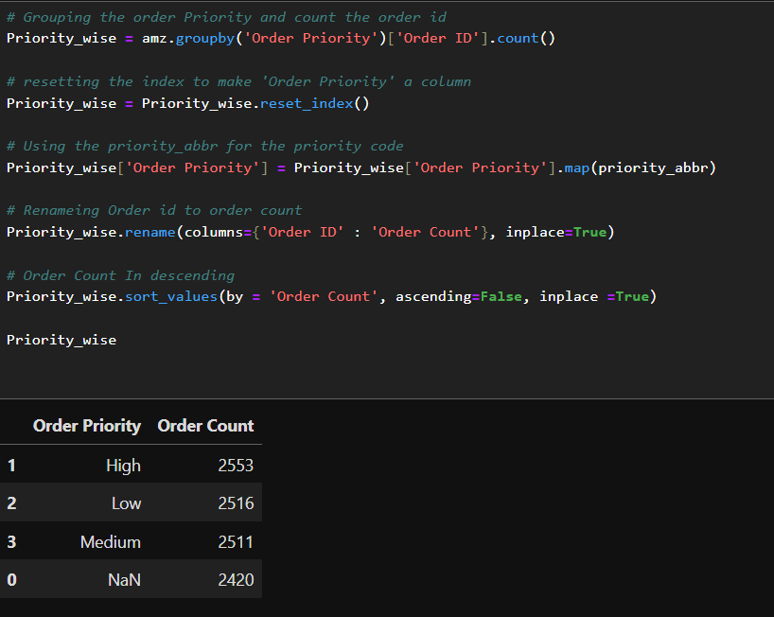
Order Priority wise Order Count

Slide 11
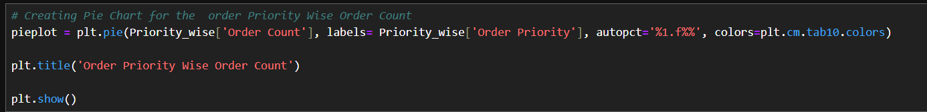
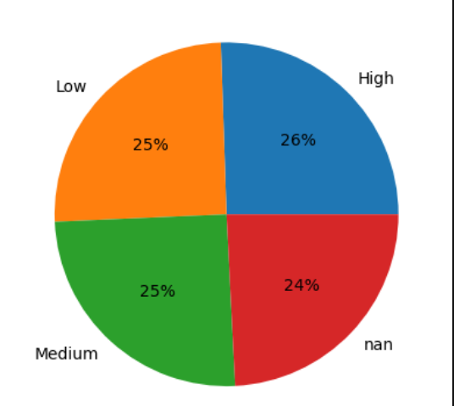
Visualizing Order Priority wise Order Count

Slide 12

03
Year, Month & Year-month Trends

Slide 13
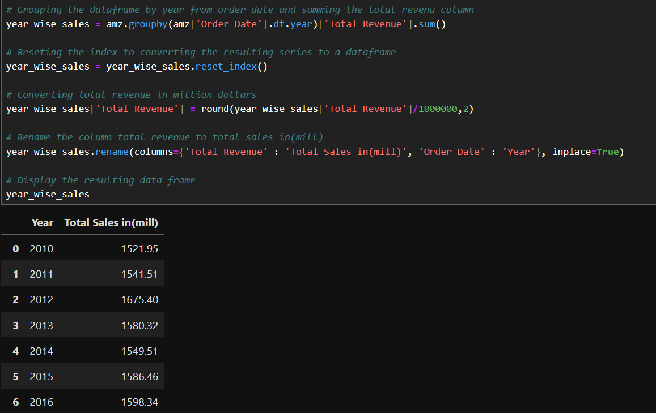
Year wise Sales

Slide 14
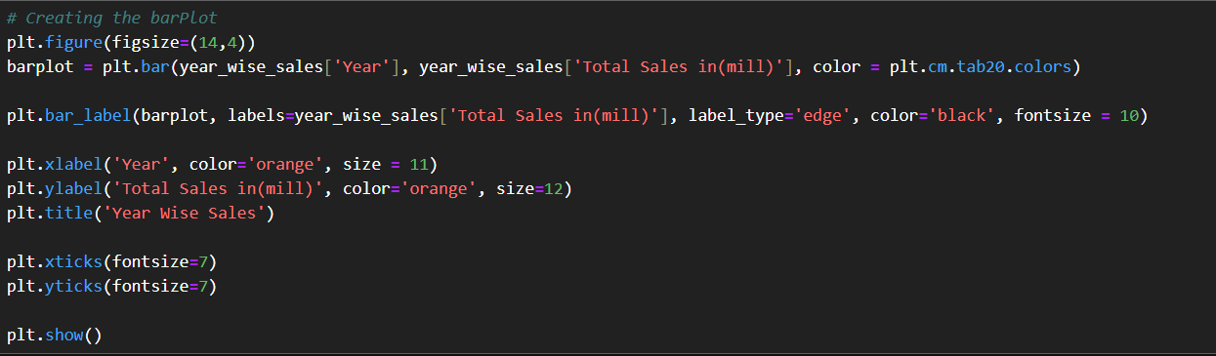
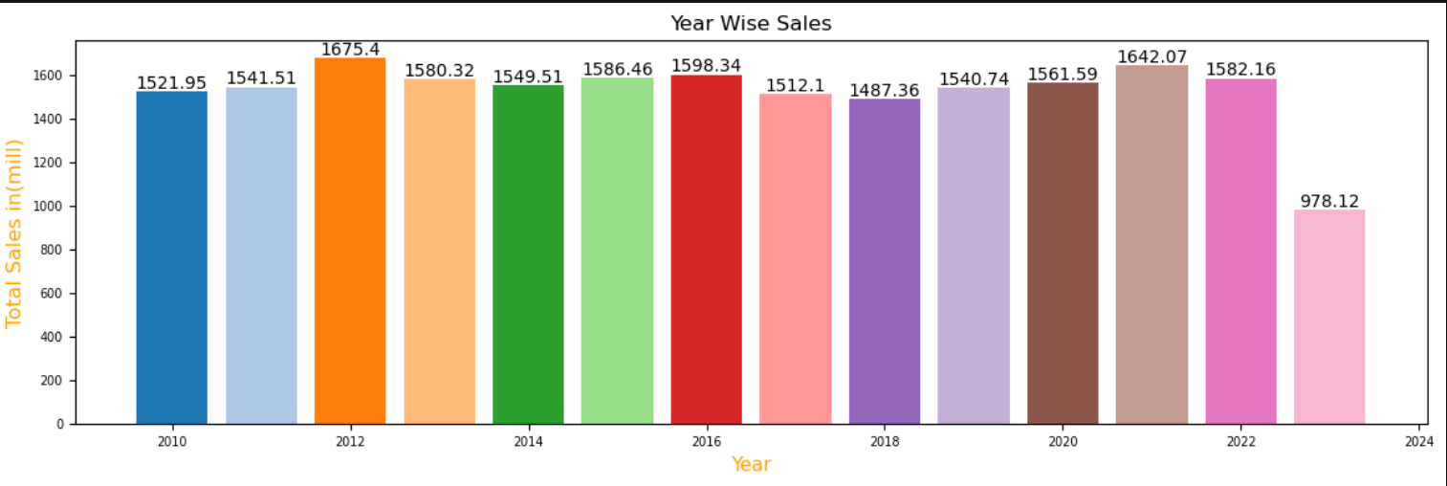
Visualizing Year wise Sales

Slide 15
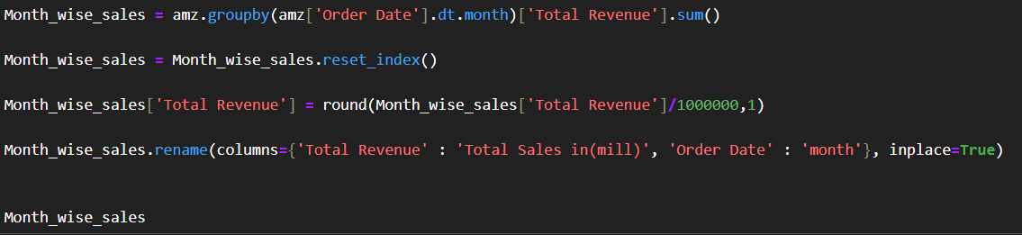
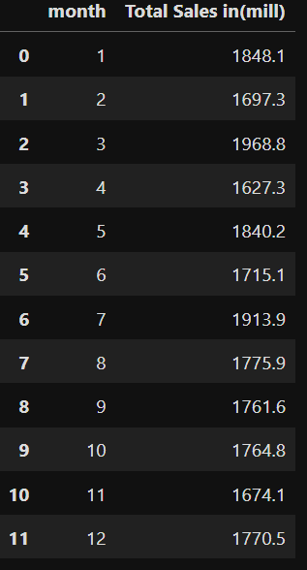
Month wise Sales

Slide 16
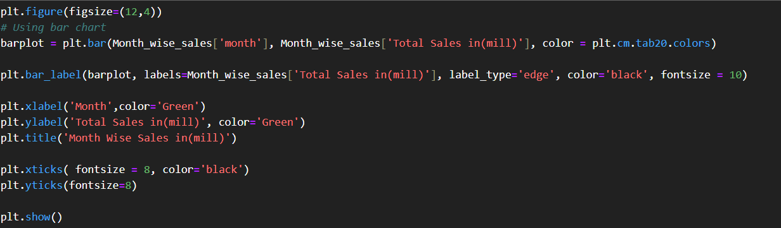
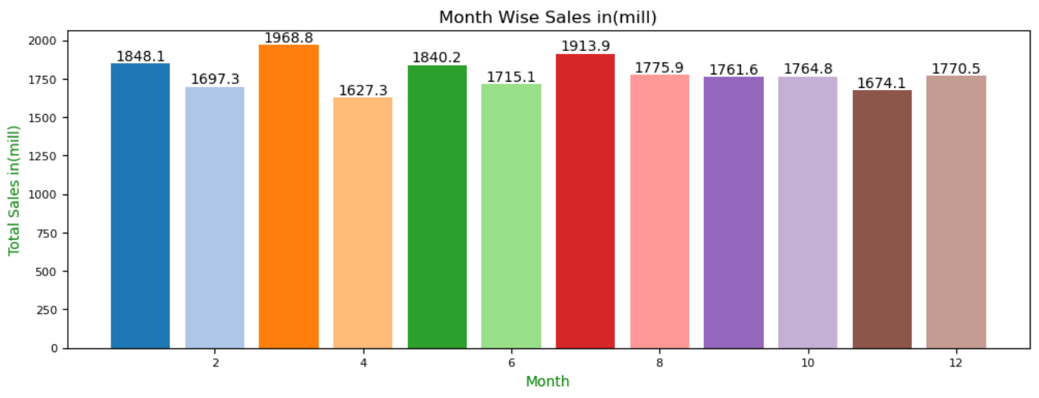
Visualizing Month wise Sales

Slide 17

04
Regional Insights

Slide 18
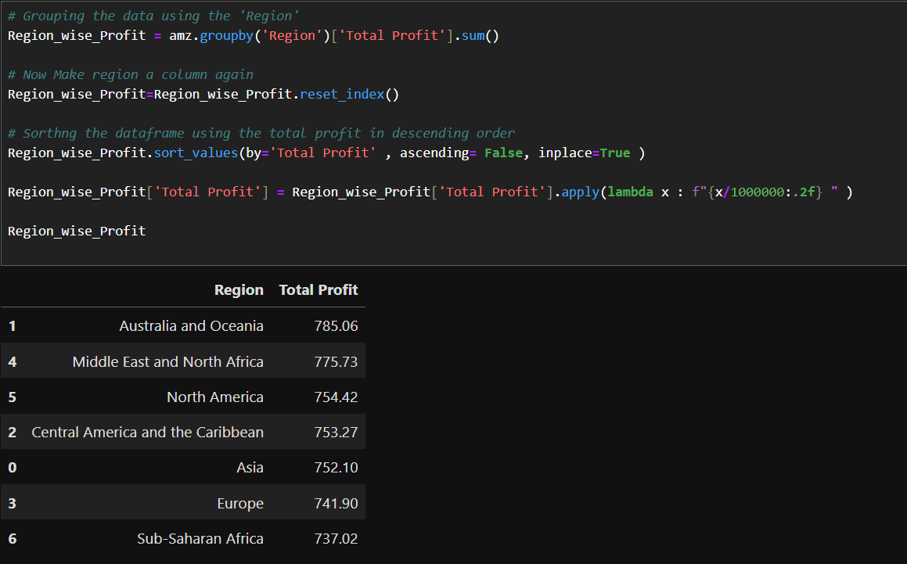
Region wise Total Profit

Slide 19
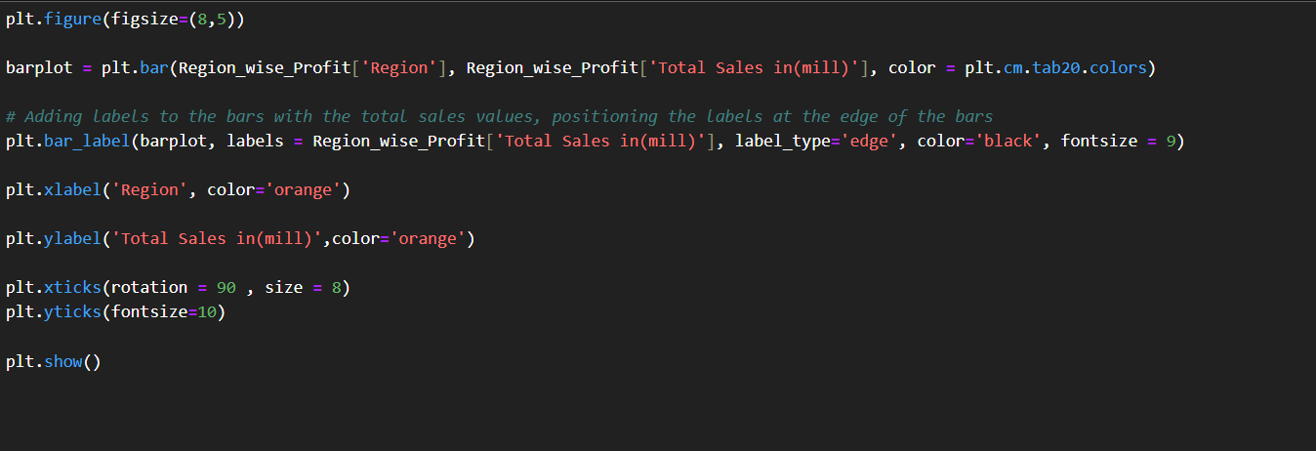
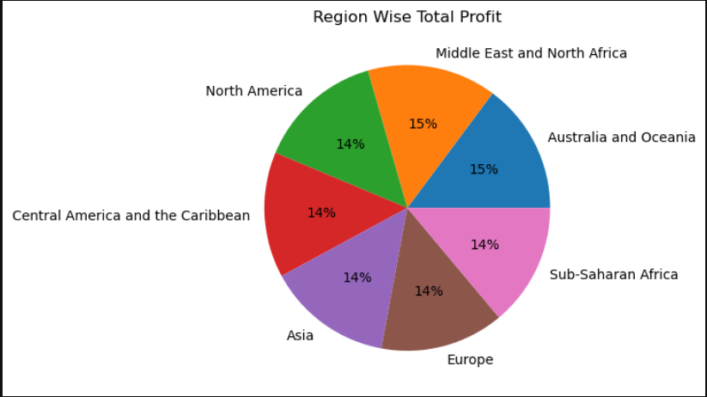
Visualizing Region wise Total Profit

Slide 20
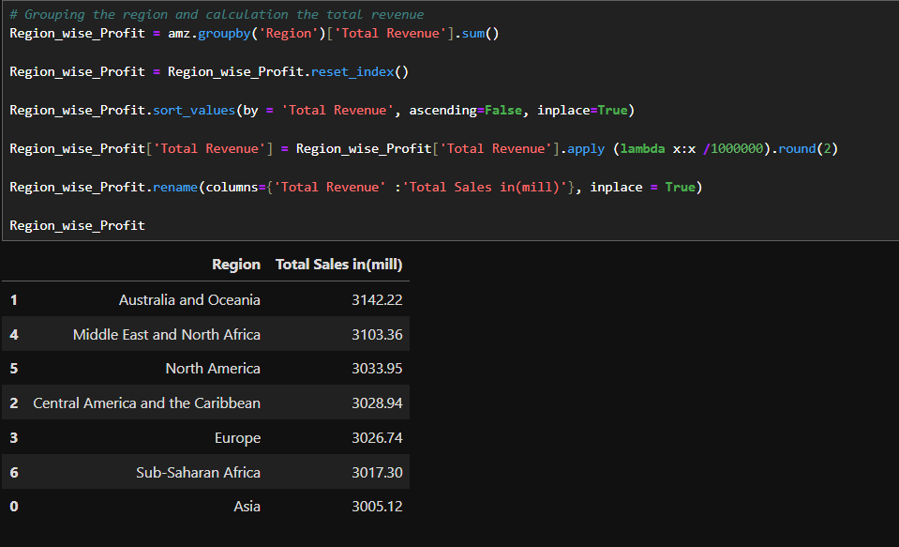
Region Wise Sales

Slide 21
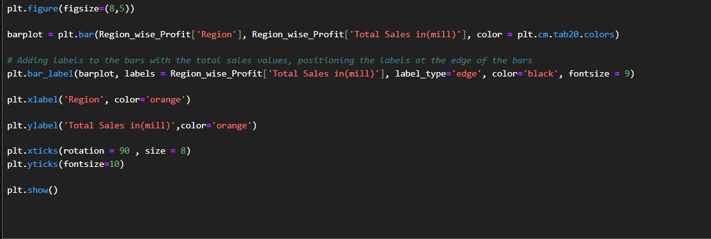
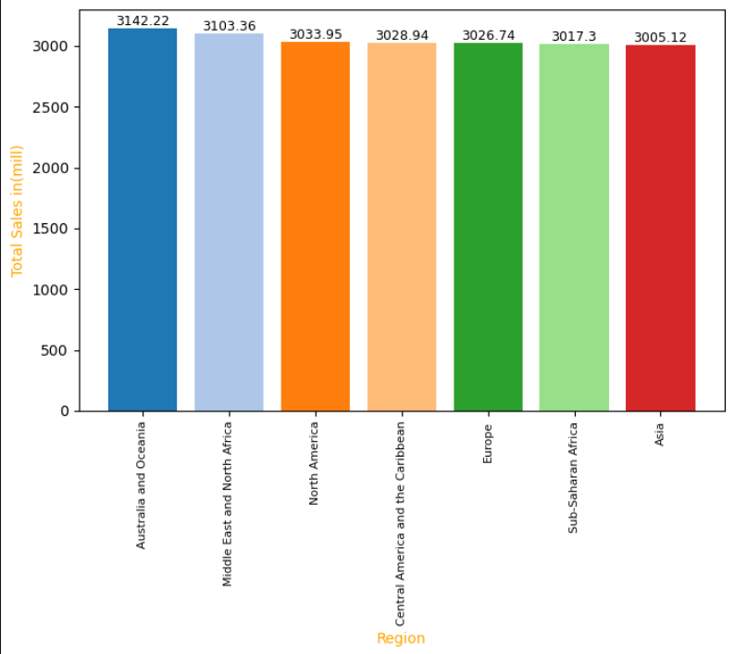
Visualizing Region Wise Sales

Slide 22
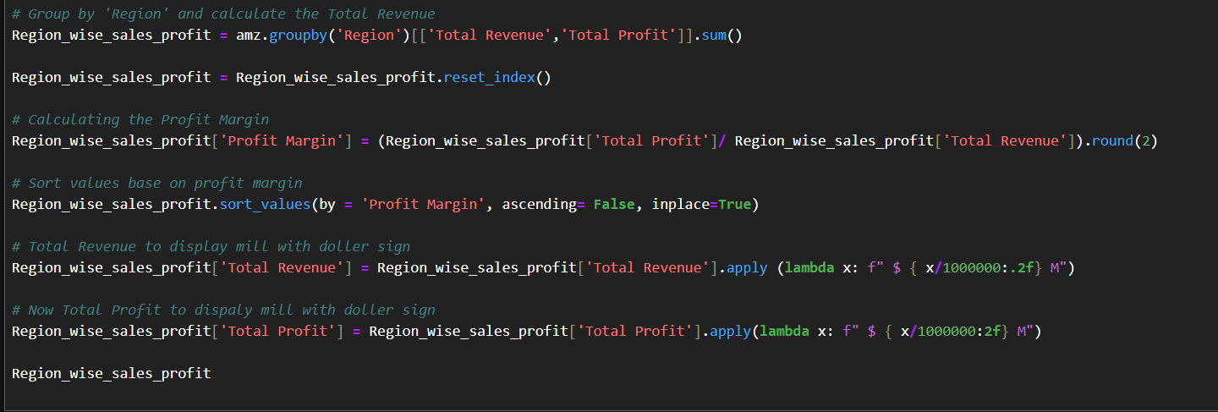
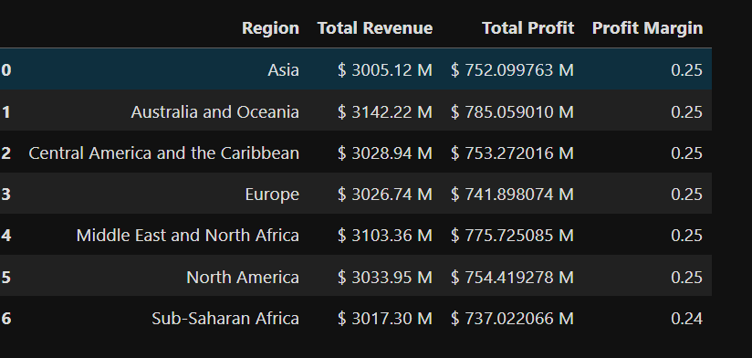
Region Wise Sales , Profit & Profit Margin

Slide 23
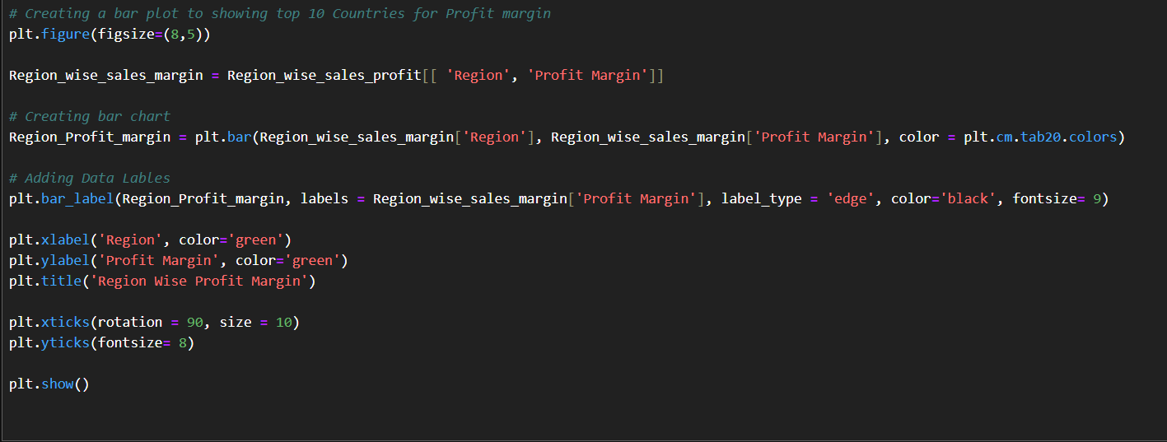
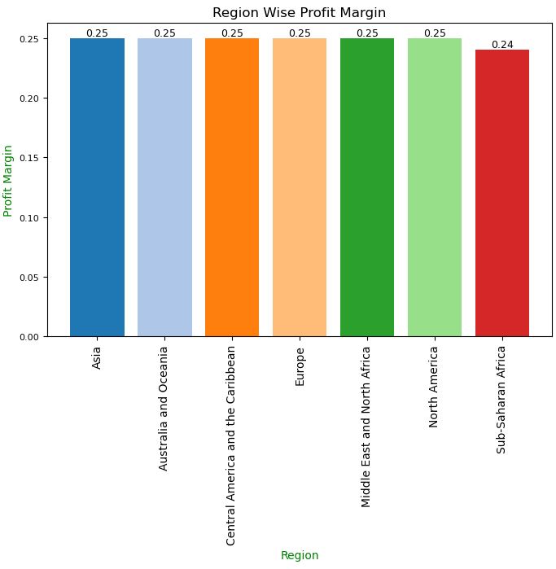
Visualizing Region Wise Profit Margin

Slide 24
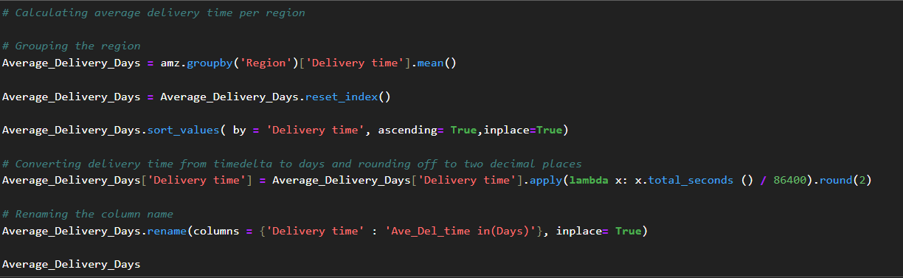
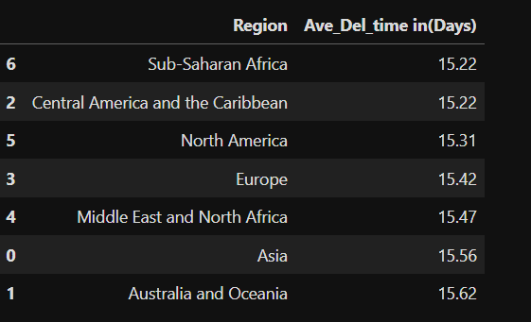
Region wise Average Delivery Time

Slide 25
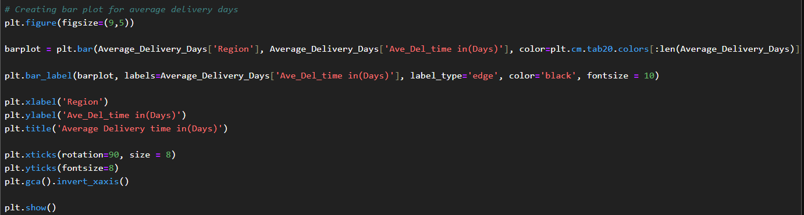
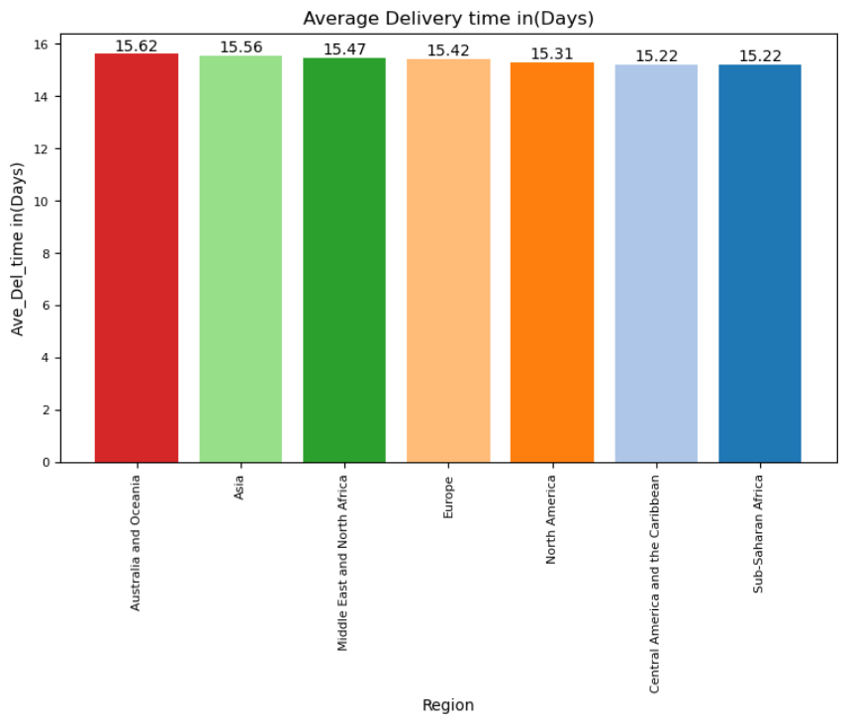
Visualizing Region wise Average Delivery Time

Slide 26

05
Order Date Overview

Slide 27
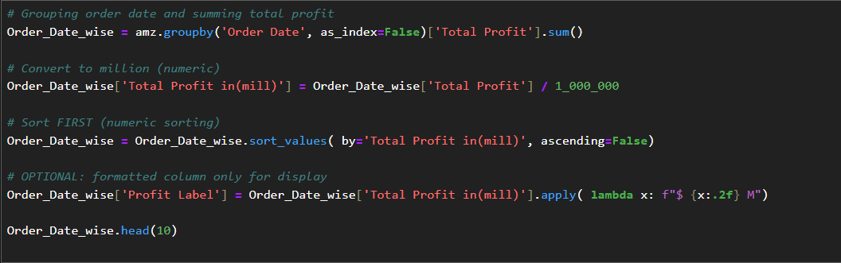
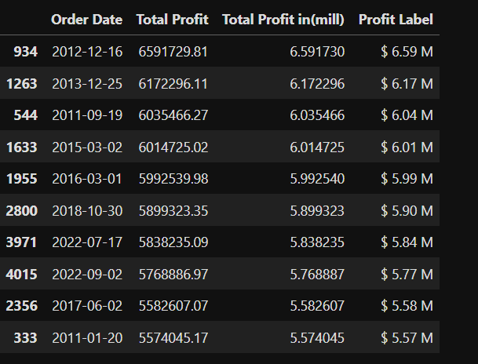
Order Date Wise Total Profit

Slide 28
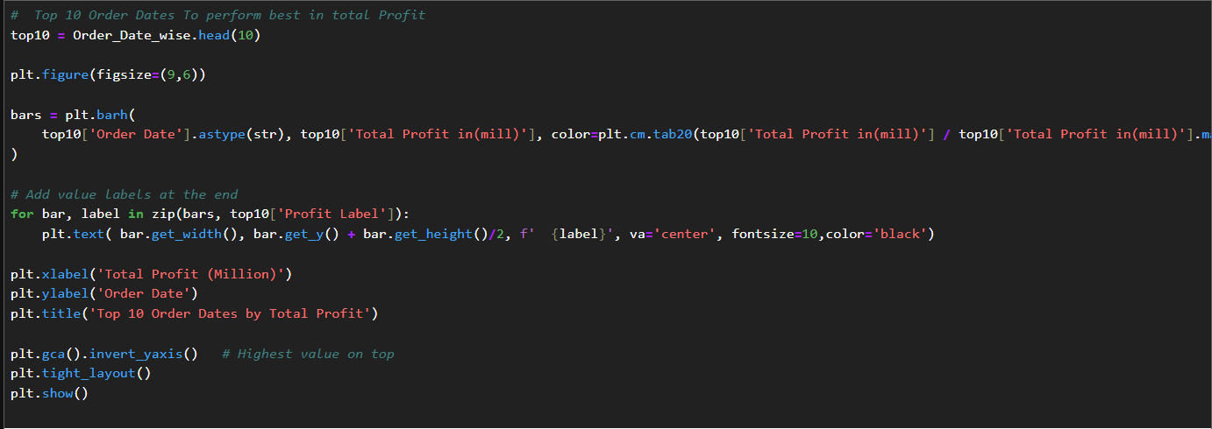
Visualizing Order Date Wise Total Profit

Slide 29
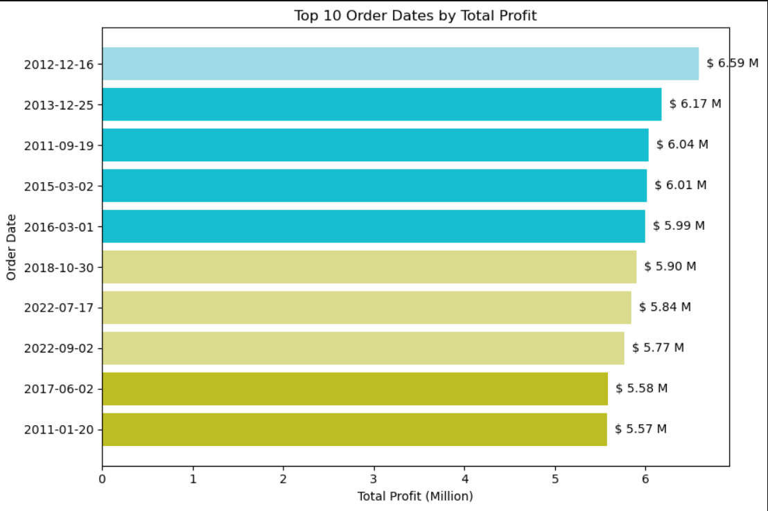
Visualizing Order Date Wise Total Profit

Slide 30

06
Country Comparison

Slide 31
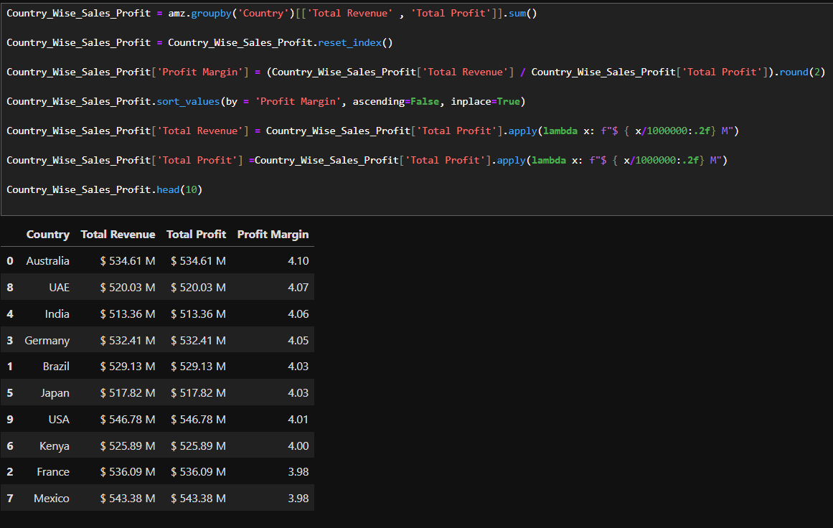
Country wise Sales, Profit & Profit Margin

Slide 32
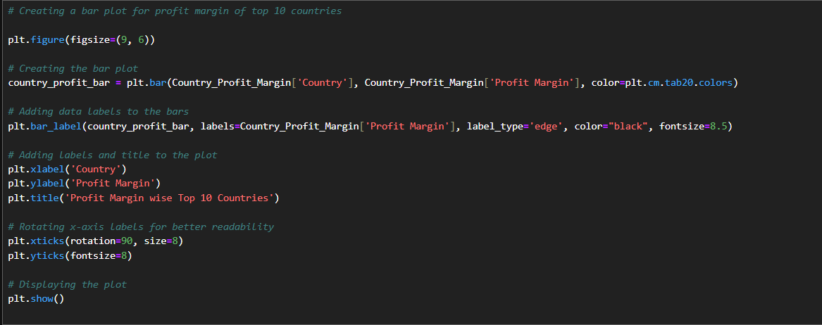
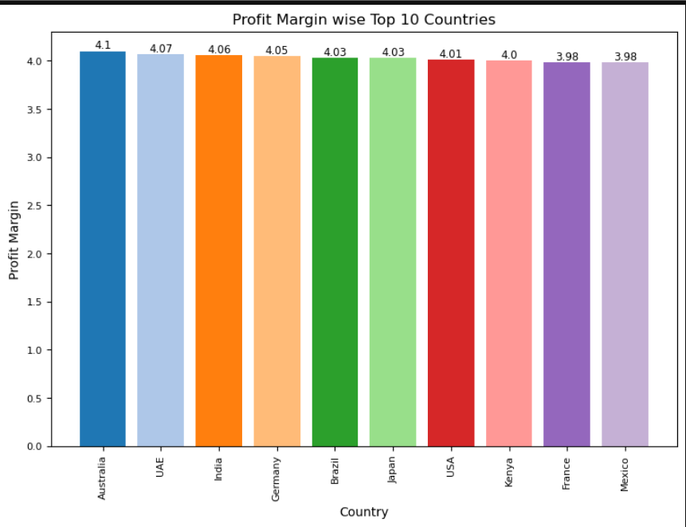
Top 10 Countries based on Profit Margin

Slide 33
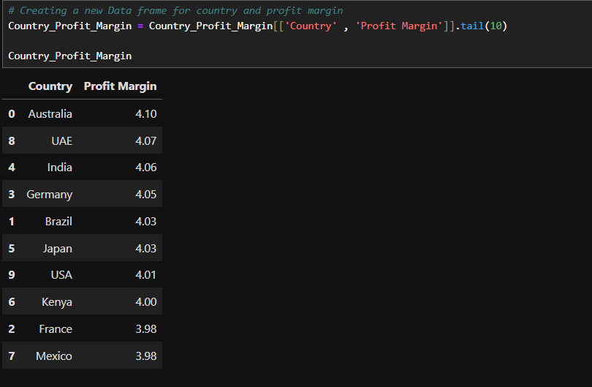
Bottom 10 Countries based on Profit Margin

Slide 34
THANK YOU!

